Slide 1
CMSC 304
Lexical Structure & Parsing Techniques
Claire Sparks

Slide 2
Syntax Analysis
Two phases:
  Lexical structure
  Syntactic structure
Lexical structure: the structure of the terminals in a language
Syntactic structure: the structure of a derivation from a language
Notes:
Lexical: What input Strings are valid
Syntactic: What ordering of tokens is valid

Slide 3
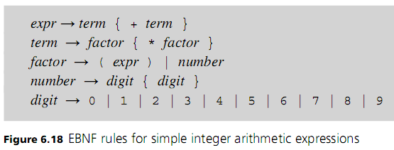
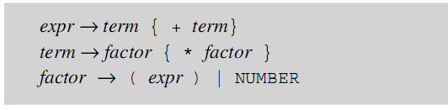
Lexical Structure
Lexical structure: the structure of the terminals in a language
  Lexis: short for lexical structure
The lexis of a language is composed of two parts
  Lexemes: logical groupings of characters
  Tokens: categories of lexemes
    Tokens can be formally defined via regular expressions
Syntactic Structure (EBNF Grammar)
Lexical Structure (Lexis)
NUMBER → [0-9]+
Notes:
Lexical: What tokens are valid
Syntactic: What ordering of tokens is valid
We have been treating lexemes and tokens as interchangeable so far
Left is the token, right is the lexeme, input, or the grouping of characters that make up the token
Token is the set of all possible lexemes of a particular category
In EBNF, we can now denote NUMBER to be a terminal
Basic Process -> group as lexemes -> categorize lexemes as tokens/classes -> These tokens are now terminals for our parse tree
Automation, we disambiguate steps.
So how do we identify lexemes?
Lexis:
Set of rules defining what lexemes are associated with what tokens

Slide 4
Lexical Structure
There can be ambiguity in determining the end of a variable-length lexeme
  Ex: doif – is this two reserved words, do and if or the identifier doif
  Ex: String x12 could be a string identifier or the identifier x and the numeric constant 12
Use principle of longest substring to eliminate confusion
  This is the process of collecting the longest possible string of nonblank characters to determine lexemes
  Ex: The longest possible string of nonblank characters is collected into a lexeme, so doif and x12 are identifiers
  Means that intervening characters, even blanks, make a difference

Slide 5
Lexical Structure
Format of a program can affect the way the lexemes are recognized:
  Lexeme delimiters (or white space) where the end of the line can have special meaning since it can also mean end of a structural entity as well as white space
  Free-format language: one in which format has no effect on program structure other than satisfying the principle of longest substring
  Lexemes can be used to determine structure (ex. { })
  Fixed format language: one in which specific tokens must occur in pre-specified locations on the page
Notes:
Most modern languages are Free-format languages. (Java C++)
Some have more significant restrictions (python uses indentation to determine structure)
“Rarely is a language fixed format, in which all tokens must occur in prespecified locations on the page.”
For example, FORTRAN circa 1966:
Column 1 - 'C' for comment
Columns 2 to 5 (maybe 1 to 5, I forget) - numeric statement label
Column 6 - if non-blank, denotes continuation of previous statement
Columns 7 to 71 - the statement
Column 72 to 80 - optional sequence number (not interpreted by FORTRAN)
Some people define python as fixed format due to it not being 100% free format. Others reserve the fixed format definition for languages with very strict location rules, such as languages designed for punchards.
https://en.wikipedia.org/wiki/COBOL#Code_format

Slide 6
Syntax Analysis
The syntax analysis portion of a language processor consists of two parts:
  Lexical structure → Scanning & Tokenizing
  Syntactic structure → Parsing
Scanning Phase: the phase in which a translator collects lexemes from the input program and associates them into tokens
Parsing Phase: the phase in which the translator processes the tokens, determining the program’s syntactic structure
The scanning phase is done by a lexical analyzer and the parsing phase by a syntax analyzer (or parser)

Slide 7
Lexical Analysis
Reasons to Separate Lexical and Syntax Analysis:
  Simplicity - less complex approaches can be used for lexical analysis; separating them simplifies the parser
  Efficiency - separation allows optimization of the lexical analyzer
  Portability - parts of the lexical analyzer may not be portable, but the parser always is portable

Slide 8
Lexical Analysis
A lexical analyzer is a pattern matcher for character strings
A lexical analyzer is a “front-end” for the parser
Identifies substrings of the source program that belong together – lexemes
Associates each lexeme with a token
Transforms an input into an ordered set of tokens

Slide 9
Lexical Analysis
Three approaches to building a lexical analyzer:
  Write a formal description of the tokens and use a software tool that constructs table-driven lexical analyzers given such a description
  Design a state diagram that describes the tokens and write a program that implements the state diagram
  Design a state diagram that describes the tokens and hand-construct a table-driven implementation of the state diagram
    Finite Automata

Slide 10
Parsing
A context free grammar describes the strings of tokens that are syntactically legal
  It also describes how a parser must act to parse correctly
Recognizer: accepts or rejects strings of tokens based on whether they are legal strings in the language
Parser: assembles valid strings of tokens together into a syntax tree
Parsers invokes the lexical analyzer to obtain the tokens of the input program, assembles the tokens together into a syntax tree, and passes the tree to the later phases of the compiler

Slide 11
Parsing
The parser is the heart of a typical compiler
It can be shown that for any context free grammar we can create a parser that runs in O(n³) time, where n is the length of the input program
There are large classes of grammars for which we can build parsers that run in O(n) time. The two most important of these classes are called:
  Left-to-right, Left-most derivation or LL
  Left-to-right, Right-most derivation or LR

Slide 12
Parsing
LL parsers are also called “top-down,” or “predictive” parsers
  They construct a parse tree from the root down, predicting at each step which production will be used to expand the current node, based on the next available token of input
  Generally considered to be simpler and easier to understand than LR parsers
  LL parsers can be written by hand or generated automatically
LR parsers are also called “bottom-up” or “shift-reduce” parsers
  They construct a parse tree from the leaves up, recognizing when a collection of leaves or other nodes can be joined together as the children of a single parent
  LR parsers are almost always constructed by a parser-generating tool
Notes:
At no point does the bottom-up parser predict what it will see next. Rather, it shifts tokens into its forest until it recognizes a right-hand side, which it then reduces to a left-hand side. Because of this behavior, bottom-up parsers are some- times called shift-reduce parsers
We are pretty much doing LL in our assignments, as it is easier to do by hand and makes more intuitive sense
LR is clustering, and using those to make a common parent until you get to the root. This is hard… Don't worry too much about this.

Slide 13
Parsing
Single-symbol lookahead: using a single token to direct an LL parse
Grammar must satisfy certain conditions to make this decision-making process work
  Parser must be able to distinguish between choices in a rule
  For an optional part, no token beginning the optional part can also come after the optional part
Notes:
The last bit is if there's ambiguity, it has to be identifiable by looking at only one token ahead.
The rules of EBNF generally satisfies this.

Slide 14
Parsing
Recursive descent parser: A LL parser whose functions correspond, one-to-one, to the nonterminals (i.e. the right-hand sides of productions) of the grammar
  Terminals are matched directly with input tokens as constructed by a scanner
  Nonterminals are interpreted as calls to the procedures corresponding to the nonterminals

Slide 15
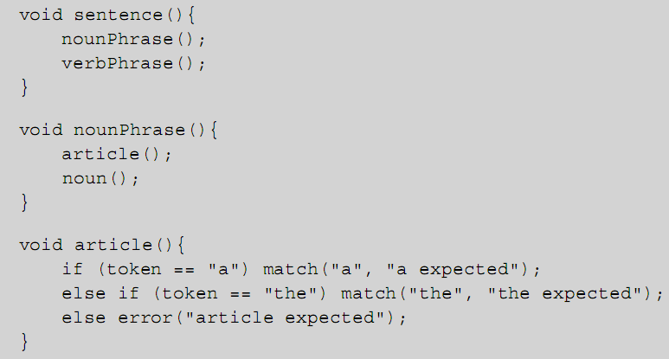
Recursive Decent Parser
Example:

Slide 16
Parsing
Left-recursive rules may present problems
  Example:
  May cause an infinite recursive loop
  No way to decide which of the two choices to take until a + is seen
The EBNF description expresses the recursion as a loop:
Thus, curly brackets in EBNF represent left recursion removal by the use of a loop

Slide 17
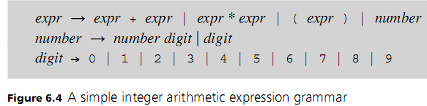
Parsing
Example:
  Parser must be able to distinguish between choices in a rule
  Can this grammar work?
  How about this one?
Notes:
The first grammar can not work
The second grammar can work
Because the first one is left recursive and will loop infinitely with single token lookahead

Slide 18
Parsing
    Lexical Structure (Lexis):
    VARTYPE -> int | void
    IDENTIFIER -> [a-z][a-zA-Z0-9]*
    BINOP -> + | * | (!=) | %
    NUMBER -> [1-9][0-9]*
    LBRACKET -> {
    RBRACKET -> }
    LPAREN -> (
    RPAREN -> )
    ASSIGN -> =
    EOL -> ;
    COMMA -> ,
    WHILEKEY -> while
    RETURNKEY -> return
Partial Grammar:
  function → header body
  header → VARTYPE IDENTIFIER LPAREN arg-decl RPAREN
  arg-decl → VARTYPE IDENTIFIER | VARTYPE IDENTIFIER COMMA arg-decl
  body → LBRACKET statement-list RBRACKET
  statement-list → statement | statement statement-list
  statement → while-loop | return | assignment | body
  while-loop → WHILEKEY LPAREN expression RPAREN statement
  return → RETURNKEY expression
  assignment → IDENTIFIER ASSIGN expression EOL
  expression → term | term BINOP term | LPAREN term RPAREN
  term → IDENTIFIER | NUMBER
Notes:
Lexis is our "terminals" what lexemes are the token classes.
The grammar tells us which one are terminals

Slide 19
Parsing
  function → header body
  header → VARTYPE IDENTIFIER LPAREN arg-decl RPAREN
  arg-decl → VARTYPE IDENTIFIER | VARTYPE IDENTIFIER COMMA arg-decl
  body → LBRACKET statement-list RBRACKET
  statement-list → statement | statement statement-list
  statement → while-loop | return | assignment | body
  while-loop → WHILEKEY LPAREN expression RPAREN statement
  return → RETURNKEY expression
  assignment → IDENTIFIER ASSIGN expression EOL
  expression → term | term BINOP term | LPAREN term RPAREN
  term → IDENTIFIER | NUMBER
    Lexical Structure (Lexis):
    VARTYPE -> int | void
    IDENTIFIER -> [a-z][a-zA-Z0-9]*
    BINOP -> + | * | (!=) | %
    NUMBER -> [1-9][0-9]*
    LBRACKET -> {
    RBRACKET -> }
    LPAREN -> (
    RPAREN -> )
    ASSIGN -> =
    EOL -> ;
    COMMA -> ,
    WHILEKEY -> while
    RETURNKEY -> return
Example for derivation:
    int gcd(int a1, int a2){
    while (a2 != 0) {
    reminder = a1 % a2;
    a1 = a2;
    a2 = reminder;
    }
    return a1;
    }

Slide 20
Parsing
  function → header body
  header → VARTYPE IDENTIFIER LPAREN arg-decl RPAREN
  arg-decl → VARTYPE IDENTIFIER | VARTYPE IDENTIFIER COMMA arg-decl
  body → LBRACKET statement-list RBRACKET
  statement-list → statement | statement statement-list
  statement → while-loop | return | assignment | body
  while-loop → WHILEKEY LPAREN expression RPAREN statement
  return → RETURNKEY expression
  assignment → IDENTIFIER ASSIGN expression EOL
  expression → term | term BINOP term | LPAREN term RPAREN
  term → IDENTIFIER | NUMBER
    Lexical Structure (Lexis):
    VARTYPE -> int | void
    IDENTIFIER -> [a-z][a-zA-Z0-9]*
    BINOP -> + | * | (!=) | %
    NUMBER -> [1-9][0-9]*
    LBRACKET -> {
    RBRACKET -> }
    LPAREN -> (
    RPAREN -> )
    ASSIGN -> =
    EOL -> ;
    COMMA -> ,
    WHILEKEY -> while
    RETURNKEY -> return
Example for derivation:
VARTYPE IDENTIFIER LPAREN VARTYPE IDENTIFIER COMMA VARTYPE IDENTIFIER RPAREN LBRACKET
WHILEKEY LPAREN IDENTIFIER BINOP NUMBER RPAREN LBRACKET
IDENTIFIER ASSIGN IDENTIFIER BINOP IDENTIFIER EOL
IDENTIFIER ASSIGN IDENTIFIER EOL
IDENTIFIER ASSIGN IDENTIFIER EOL
RBRACKET
RETURNKEY IDENTIFIER EOL
RBRACKET
Notes:
Note, each token should have a reference to it’s associated lexeme!

Slide 21
Syntax vs. Semantics
Some rules are context-sensitive and cannot be written as context-free rules
Examples:
  Declaration before use for variables
  No redeclaration of identifiers within a procedure
These are semantic properties of a language
Another conflict occurs between predefined identifiers and reserved words
  Reserved words cannot be used as identifiers
  Predefined identifiers can be redefined in a program

Slide 22
Syntax vs. Semantics
Syntax and semantics can become interdependent when semantic information is required to distinguish ambiguous parsing situations
Example: C where type names and variable names must be distinguishable during parsing
  (x) -y must have context information on identifiers available to disambiguate such situations
  If x is a type name and this cast of the value –y to type x
  If x is a variable name then this is subtraction of y from x

Slide 23
CMSC 403
Semantics
Claire Sparks

Slide 24
Introduction
Syntax: the form or structure of the expressions, statements, and program units
Semantics: the meaning of the expressions, statements, and program units
Syntax and semantics provide a language’s definition
It is conventional to say that the syntax of a language is precisely what can be described conveniently by a context-free grammar, while the semantics is that portion of the definition that cannot
Notes:
Syntax for compile time
Semantics for runtime

Slide 25
Semantics
Semantic rules are further divided into static and dynamic semantics
The static semantics of a language is only indirectly related to the meaning of programs during execution
  Rather, it has to do with the legal forms of programs (syntax rather than semantics)
  Static semantics are enforced at compile time
Dynamic semantics, or meaning, of the expressions, statements, and program units of a programming language
  Dynamic semantics are enforced at run time

Slide 26
Static Semantics
Context-free grammars (CFGs) cannot describe all of the syntax of programming languages
Categories of constructs that are trouble:
  Context-free, but cumbersome (e.g., types of operands in expressions)
  Non-context-free (e.g., variables must be declared before they are used)
Static semantics are used to enforce these constructs
Static semantics are more about structure than meaning

Slide 27
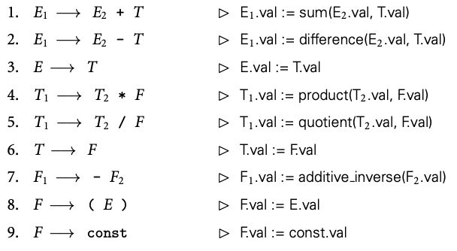
Attribute Grammars
The most common way of applying semantics are attribute grammars
An attribute grammar is a context-free grammar with the following additions:
  Each nonterminal is associated with a set of attributes
  Each production has a set of rules that define attributes of the nonterminals
Notes:
context-free gramar with additions
In this example, there is one attribute → val
Each rule specifies how the value attribute is defined for a specific nonterminal

Slide 28
Attribute Grammars
Attribute grammar rules come in two forms:
Copy rules: specify that one attribute should be a copy of another
Semantic functions: Arbitrarily complex functions specified by the language designer
  Each semantic function takes an arbitrary number of arguments, and each computes a single result, which must likewise be assigned into an attribute of a symbol in the current production
In a strict definition of attribute grammars, copy rules and semantic function calls are the only two kinds of permissible rules
Neither the notation for semantic functions nor the types of the attributes is intrinsic to attribute grammars
Notes:
copy rules and semantic functions basically cover everything and can apply semantic meaning to a parse tree
there is fancier stuff, but we don't need to cover that
Last bullet: EBNF is formalized, Attribute grammars are much less so. This is a concept applied in different ways and places

Slide 29
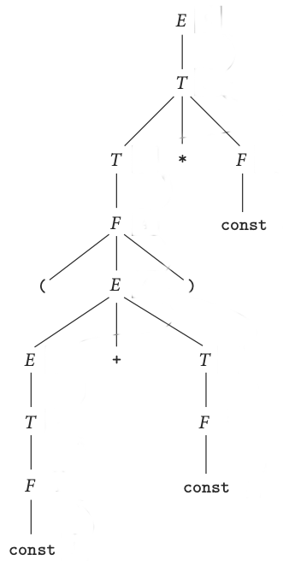
Attribute Grammars
Parse tree for: (1 + 3) * 2
Can we use the attribute grammar to calculate an answer?
Notes:
We're using a parse tree here but can be easily adapted to an AST
Left is EBNF, right is our attribute grammar rules
These are dynamic semantics because the values won’t be calculated until runtime
Static dynamics would include things like data types

Slide 30
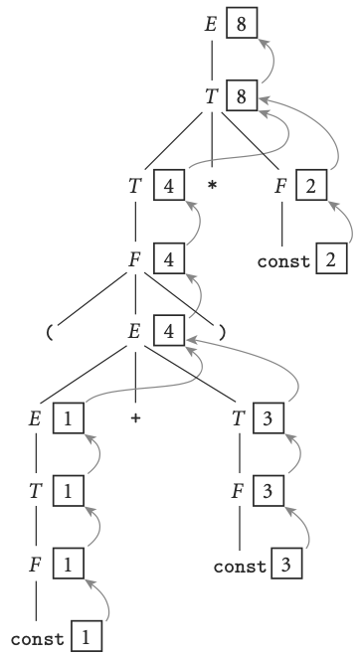
Attribute Grammars
Parse tree for: (1 + 3) * 2
Can we use the attribute grammar to calculate an answer?
Notes:
Find grammar rule, apply attribute rule
…get to sum…sum is arbitrary, and would actually have to be defined somewhere (e.g. machine language, c, whatever we want)

Slide 31
Attribute Grammars
Attributes come in two forms as well
Synthesized attributes: values are calculated (synthesized) only in productions in which their symbol appears on the left-hand side
  The previous example was exclusively synthesized attributes
Inherited attributes: Attributes whose values are calculated when their symbol is on the right-hand side of the current production
Notes:
We were only using synthesized attributes earlier

Slide 32
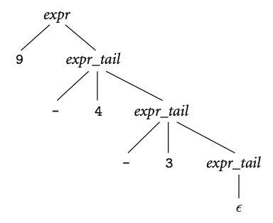

Inherited Attributes
Parse tree for: 9 – 4 – 3
Defining an attribute grammar presents a problem
Because subtraction is left associative, we cannot summarize the right subtree of the root with a single numeric value
Solution is to to pass attribute values not only bottom-up but also left-to-right in the tree
Notes:
Left associative, remember that 9-4 has to happen BEFORE we do the subtraction of 3

Slide 33
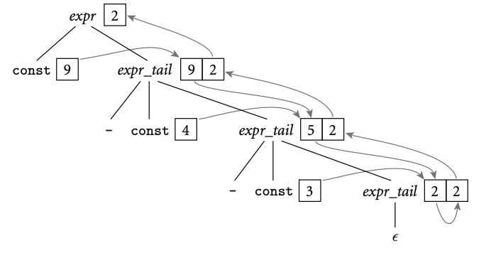
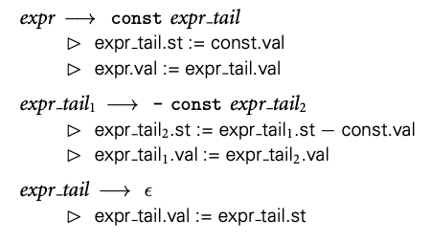
Inherited Attributes
In each of the first two productions, the first rule serves to copy the left context into a “subtotal” (st) attribute
The second rule copies the final value from the right-most leaf back up to the root

Slide 34
Attribute Flow
An attribute grammar does not specify the order in which attribute rules should be invoked
This means that the order in which attribute rules are listed for a given production is immaterial; attribute flow may require them to execute in any order
Noncircular attribute grammar: An attribute grammar where no attribute, in any parse tree, ever depends (transitively) on itself.
  Attribute grammars tend to be noncircular
Notes:
Where do we go and when is complicated!
This is complicated
Remember, that was only 3 grammar rules back there.
Make sure these are non-circular (make sure there's no infinite loop)
We are not mathmeticians

Slide 35
Attribute Flow
Translation scheme: An algorithm that decorates parse trees by invoking the rules of an attribute grammar
Simplest scheme is one that makes repeated passes over a tree, invoking any semantic function whose arguments have all been defined, and stopping when it completes a pass in which no values change
  Such a scheme is said to be oblivious
Notes:
This slide is basically saying is do it as it comes. In reality, it's complicated. but this is terribly inefficient

Slide 36
Attribute Flow
Better performance may be achieved by a dynamic scheme that tailors the evaluation order to the structure of a given parse tree
  The fastest translation schemes tend to be static: based on an analysis of the attribute grammar itself
Once decorated, the program node at the root of the syntax tree will contain a list, in a synthesized attribute, of all static semantic errors in the program
  The list will be empty if the program is free of such errors
Notes:
we use this to apply static semantics.
We generally don’t want to deal with this.
We usually have tools to do this for us (apply semantics). This is here is for context, you will not be assessed on this attribute flow stuff

Slide 37
Semantics
Syntax: what the language constructs look like
Semantics: what the language constructs actually do
Specifying semantics is more difficult than specifying syntax
Several ways to specify semantics:
  Language reference manual
  Defining a translator
  Formal definition
Notes:
We’re about to explain these three options

Slide 38
Semantics
Specifying semantics is more difficult than specifying syntax
There is no single widely accepted way of formally describing semantics
As a result, semantics are defined either formally or informally
The three major classes of formal notation are:
  Operational Semantics
  Axiomatic Semantics
  Denotational Semantics

Slide 39
Informal Semantics
Language reference manual:
  Most common way to specify semantics
  Provides clearer and more precise references
  Suffers from a lack of precision inherent in natural language descriptions
  May have omissions and ambiguities
Notes:
https://docs.oracle.com/javase/specs/jls/se13/html/index.html

Slide 40
Operational Semantics
The definition of a translator is also known as operational semantics
Operational Semantics
  Describe the meaning of a program by executing its statements on a machine, either simulated or actual. The change in the state of the machine (memory, registers, etc.) defines the meaning of the statement
To use operational semantics for a high-level language, a virtual machine is needed
Notes:
pseudo formal. Meaning is what computer does lol. It's how we learn programming, but not great for formal definition

Slide 41
Operational Semantics
A hardware pure interpreter would be too expensive
A software pure interpreter also has problems
  The detailed characteristics of the particular computer would make actions difficult to understand
  Such a semantic definition would be machine dependent
Notes:
Basically, you créate a computer program that "defines" your language.
If this has a bug…it's not a bug, it's a feature…If the machine defines the language, mistakes

Slide 42
Operational Semantics
A better alternative: a complete computer simulation
The process:
  Build a translator (translates source code to the machine code of an idealized computer)
  Build a simulator for the idealized computer
Evaluation of operational semantics:
  Good if used informally (language manuals, etc.)
  Extremely complex if used formally (e.g., VDL), it was used for describing semantics of PL/I.
Notes:
often used as a supplemental tool

Slide 43
Operational Semantics
Pros:
  Questions about a language can be answered by experimentation
Cons:
  Questions about program behavior cannot be answered in advance
  Bugs and machine dependencies in the translator may become part of the language semantics, possibly unintentionally
  May not be portable to all machines
  May not be generally available

Slide 44
Axiomatic Semantics
Axiomatic Semantics:
  Based on formal logic
  Original purpose: formal program verification
Axioms (inference rules) are defined for all statements in the language (to allow transformations of expressions to other expressions)
Expressions are called assertions
  pre-conditions: assertions before a statement
  post-conditions: assertions after a statement
Notes:
This is a proof…this is an entire field of mathematics…not usable by most programmers…

Slide 45
Denotational Semantics
Based on recursive function theory
Formal mathematical methods: precise, but are also complex and abstract
Requires study to understand
Defining a Denotational specification:
  Define a function mapping language entities onto math objects
  Transformation of entities must be explained through math manipulations
Due to its complexity, it isn’t commonly used outside of academia
Notes:
This also a lot of work…

